Slide 1

BLOOD BANK MANAGEMENT SYSTEM

Slide 2
OUR TEAM
Shivam Sikotra
Shyamkumar Patel
Viral Biyawala

Slide 3
Problem Statement
TABLE OF CONTENTS
01
02
Project Overview
03
04
Diagrams
Design & Implementation
05
06
Challenges during
Implementation
Conclusion

Slide 4
PROBLEM STATEMENT
Current blood bank systems, managed manually and using outdated methods, lead to errors and delays. Hospitals also face challenges in making blood requests efficiently. We need a modern, user-friendly solution to ensure precise blood donation, distribution, and timely responses to hospital requests.

Slide 5


MOTIVATION
Lifesaving Impact
Our motivation is fueled by a profound desire to enhance healthcare outcomes.
Healthcare Accessibility
We are driven by a vision of improved healthcare accessibility.

Slide 6
— Wayne Chirisa
“With every heart beat we live to see the sunset, with each drop of blood donated; another precious life will live to see the sunrise.”

Slide 7
Project Overview
Description
A web-based software that provides an all-in-one platform for blood bank management operations
Target Users
Hospitals and other healthcare facilities, as well as blood donors and recipients
Key Features
Blood stock management, donor registration, and blood request

Slide 8

DIAGRAMS

Slide 9
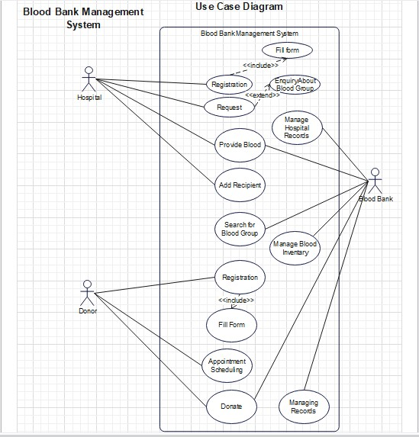
Use Case Diagram

Slide 10
Use Case Diagram

Slide 11
Use Case Diagram

Slide 12
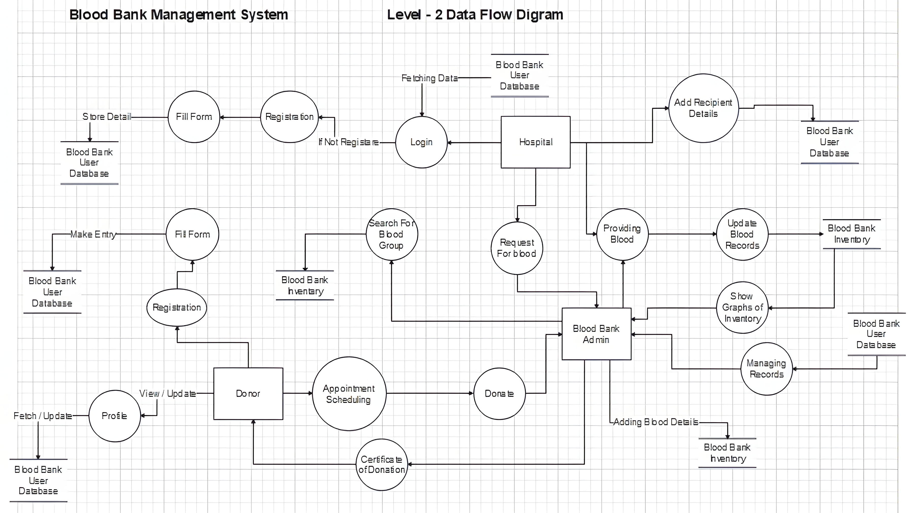
Data Flow Diagram

Slide 13

USER INTERFACE

Slide 14
NAV I GA T I ON
Simplified Navigation
The navigation is designed to be simple and straightforward, ensuring that users can easily access essential features without unnecessary complexity.
Role Specific Interfaces
Different user roles (donors, hospitals, administrators) have interfaces tailored to their specific needs
Notification System
Implementing a notification system ensures that users receive timely updates

Slide 15
L A Y O U T
Visual Representation
Incorporating visual aids, such as charts and graphs, enhances data comprehension for administrators
Real time Metrics
The inclusion of real-time metrics and analytics allows administrators to monitor and analyze trends, making data-driven decisions to optimize blood bank operations.
Mobile Responsiveness
The user interface is not only optimized for desktops but is also responsive on mobile devices, ensuring accessibility anytime, anywhere.

Slide 16



REGISTRATION PROCESS
Authentication using OTP
Sign Up
Enrolment

Slide 17

INVENTORY MANAGEMENT

Slide 18
Blood Inventory
Detailed snapshot of available blood for all blood groups
Blood Stock Availability
Enables administrators to view the quantity of each blood type available in the selected city

Slide 19

Specializations
CONTINUOUS
MONITORING
LOW STOCK
ALERTS
Real-time updates offer administrators continuous monitoring capabilities
System generates alerts for low stock situations

Slide 20

ADMIN DASHBOARD

Slide 21

Visual Analytics
Donation Trends
Pending Requests Overview
Individual Graph
Insights

Slide 22


Extra Features
INVENTORY
SEARCH
FUNCTIONALITY
DYNAMIC
UPDATES
Real-time updates ensure that the data presented on the dashboard is current and accurate
Allowing administrators to explore the blood inventory by city or specific blood group

Slide 23
DATABASE MANAGEMENT

Slide 24
COMPONEN T S
Tables
Organized tables (RDonor, RHospital, Donor, Recipient) offering clarity and dedicated segments for each system aspect.
Relationships
Foreign key relationships establish meaningful connections, maintaining data integrity.
Normalization
Adherence to normalization principles minimizes redundancy and ensuring efficient resource utilization.

Slide 25
SECURITY
Encryption
Sensitive data undergoes encryption, using advanced algorithms to fortify against unauthorized access
Access Control
Ensuring only authorized individuals have appropriate database access, maintaining data confidentiality.

Slide 26

TOOLS & TECHNOLOGIES

Slide 27













Slide 28



SECURITY MEASURES
Verified Email Registration
Password Security
Role-Based Access Control (RBAC)

Slide 29


CHALLENGES DURING IMPLEMENTATION
Delayed Response Times
Inaccuracies in Inventory
Resource Inefficiencies

Slide 30
Conclusion
The Blood Bank Management System transforms healthcare by eliminating manual inefficiencies and ensuring robust security. Success is attributed to user-friendly interfaces, efficient database management, and the Admin Dashboard, fostering donor engagement and optimizing blood distribution.
Future Scopes
The system's future potential extends to more geographical locations with predictive analytics, mobile apps, and collaborations. Continuous updates position the Blood Bank Management System as a pioneering solution, advancing healthcare efficiency globally.

Slide 31
THANKS!
Does anyone have any questions?
lifesaver102023@gmail.com

